Slide 1
Technologies and Strategies for Administrative Professionals in 2010
Presented to the International Association of Administrative Professionals, Clifton Corridor Chapter
July 15, 2010
Chuck Elliott, M.S., M.P.A.
Chuck.Elliott@gmail.com

Slide 2
“The winners will be those professionals who master technology, effectively use their interpersonal and communication skills, have the ability to track and organize and be creative in solving problems, and most importantly, have the willingness to learn and grow, and accept challenges. For these administrative professionals, there is a world of opportunity waiting for them!” http://www.iaap-hq.org/researchtrends/21centuryadmin.htm

Slide 3
Today’s Topics
What is an Office Suite?
Some Common Office Suites
Demo of Microsoft Office 2010
File Formats and Compatibility
Information Security and Compliance
Collaboration Software and Services
Mastering the Technology
Q&A

Slide 4
What is an Office Suite?
Office Application Suites are collections of applications which usually include:
Word processor
Spreadsheet
Presentation or slide show creation
E-mail and schedule management (Outlook)
Server component (Exchange, GroupWise)
Database (less common, more $)
Additional applications may be available, $$$
Project management
Drawing or diagramming

Slide 5
Common Office Suites Available in 2010
Free
Google Docs
Free and Open Source
OpenOffice.org
GNOME Office
Proprietary
Microsoft Office
WordPerfect Office
StarOffice
others

Slide 6
Microsoft Office 2010
Microsoft Office 2010 Professional
How to get it?
Cost – approximately $139 for the Home & Student Edition
Approximately $20 for Emory employees willing to sign the work-at-home agreement
Free web version at www.officelive.com
Demo

Slide 7
File Formats and Compatibility
The 2007 Office system release introduced a default file format for Office Word 2007, Office Excel 2007, and Office PowerPoint 2007. The default format was changed to XML in response to customer requests. XML format provides the following benefits:
Enables more rapid document creation from different data sources
Enables easier data mining and content reuse
Reduces the size of Word, Excel, and PowerPoint files
Improves data recovery in corrupted files
OneNote 2010 and Outlook 2010 have new file formats

Slide 8
Information Security and Compliance
Administrative Professionals comply with security requirements
Sarbanes-Oxley
HIPAA
FERPA
Privacy Act
Know the policies
e.g., http://policies.emory.edu
Consult the experts
Protect the obvious
Social Security Numbers
Patient and Patron data
Student Data
Confidential Data
Protect your passwords!
And change them often

Slide 9
Use Encryption When Needed
Encrypted data is considered secure
Good encryption software is not hard to use
A recommended free program is here
www.TrueCrypt.org
Consider CDs, DVDs, USB drives, laptops
Full Disk Encryption (FDE)

Slide 10
Caution when Surplusing Equipment
When surplusing equipment ensure sensitive data is protected
Encrypt the drive
Wipe the drive
Remove the drive and/or replace it
CDs and DVDs can be shredded

Slide 11
Collaboration Software & Services
Microsoft Exchange
Microsoft SharePoint
BlackBoard
Microsoft Office Live
www.officelive.com
Google Apps
http://www.google.com/apps/
DropBox
www.dropbox.com

Slide 12
Mastering the Technology
Practice, Practice, Practice
Learn something new every day
Use built-in help
Use free Internet resources
Microsoft Office 2010 Outlook: What's New? – Video
http://www.youtube.com/watch?v=u5_GrWyicZ8
Advanced “What’s new in Office 2010?”
http://channel9.msdn.com/posts/matthijs/Whats-new-in-Office-2010/

Slide 13
Mastering the Technology (2)
Free publications
184 pages
http://blogs.msdn.com/b/microsoft_press/archive/2010/01/20/free-ebook-first-look-microsoft-office-2010.aspx

Slide 14
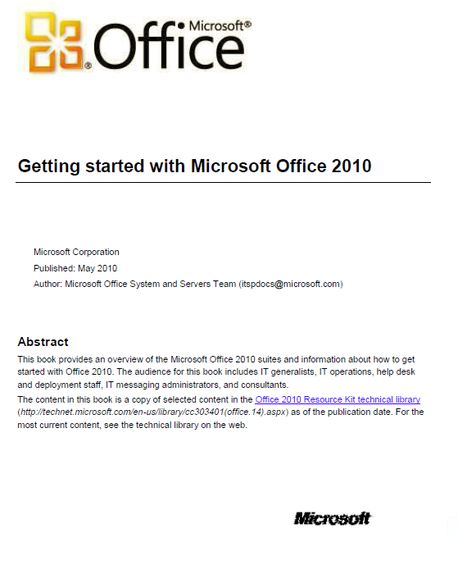
Mastering the Technology (3)
More Free publications
259 pages
http://www.microsoft.com/downloads/details.aspx?FamilyID=860761E2-CE6A-408D-A52D-67F8E6A9388E&displaylang=en

Slide 15
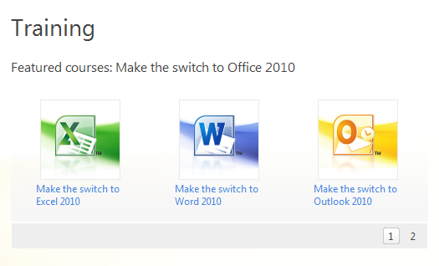
Mastering the Technology (4)
Free Microsoft Training
http://office.microsoft.com/en-us/support/training-FX101782702.aspx

Slide 16
Mastering the Technology (5)
Best Recommended Computer Based Training
www.Lynda.com

Slide 17
Thank You!

Slide 18
Chuck.Elliott@gmail.com
?

